Slide 1
11.6 Efficient Cross-Validation via Regularization

Slide 2
Overfitting occurs when:
the *capacity* of a machine learning model is too high
*and*, its corresponding cost function (over the training data) is *optimized* too well.
Regularization - a potential solution:
we set the model parameters purposefully away from the global minimum of its associated cost function, so as to find where the validation error (not training error) is at its lowest.

Slide 3
Two most popular approaches to regularization:
Early stopping
Adding a regularizer to the cost function

Slide 4
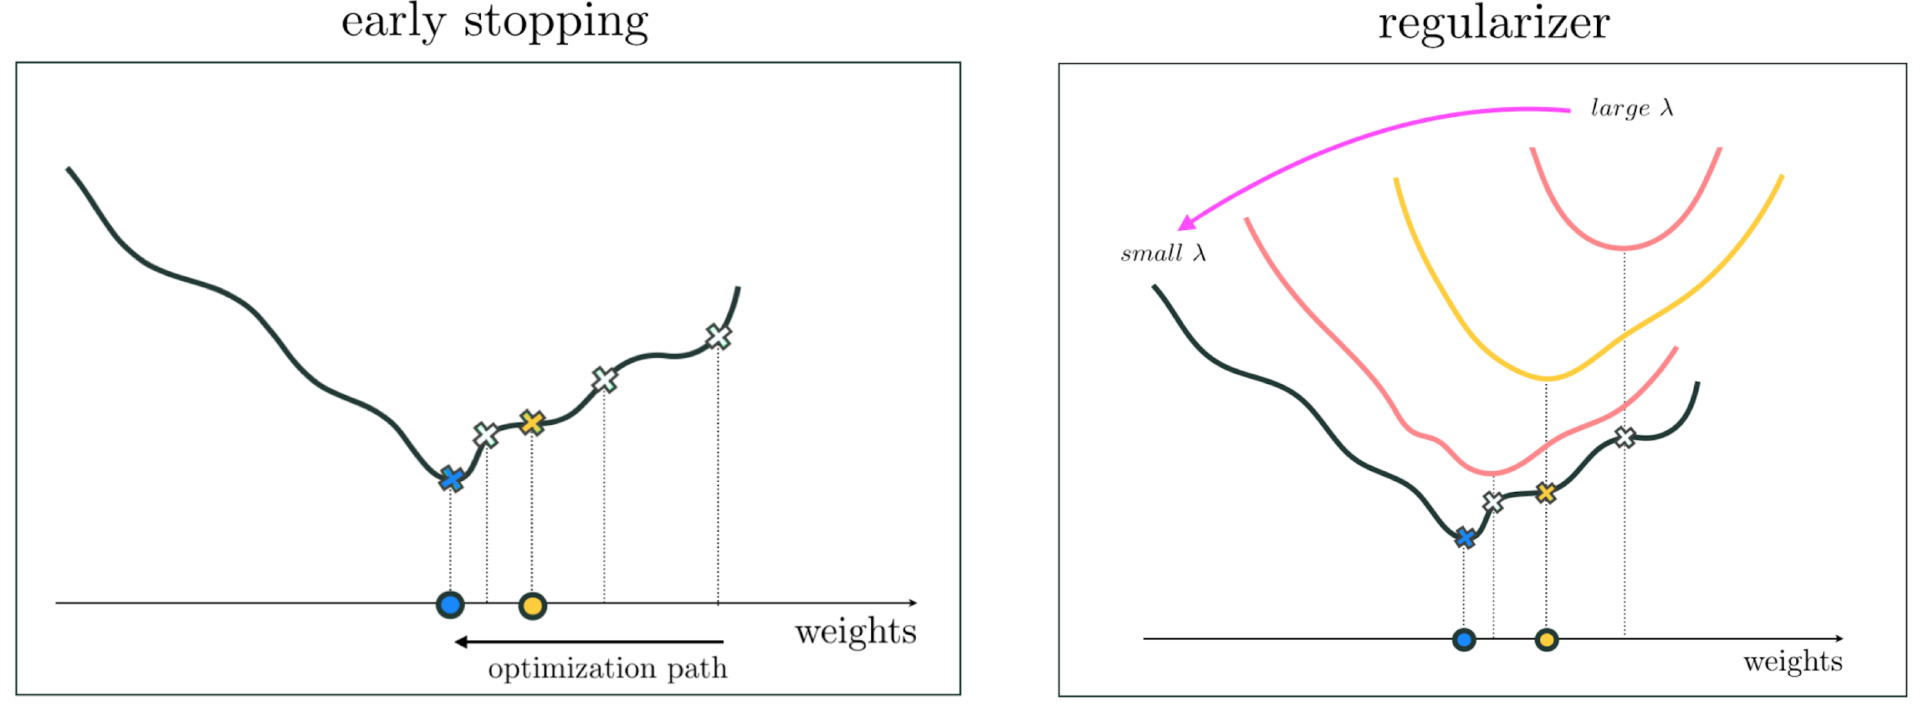
(left panel) A figurative illustration of early stopping regularization: we stop the optimization prematurely at the yellow point (where validation error is minimal).
(right panel)A figurative illustration of regularizer based regularization: by adding a regularizer function to the cost associated of a high capacity model we change its shape, in particular dragging its global minimum where overfitting behavior occurs away from its original.

Slide 5
Early stopping based regularization

Slide 6
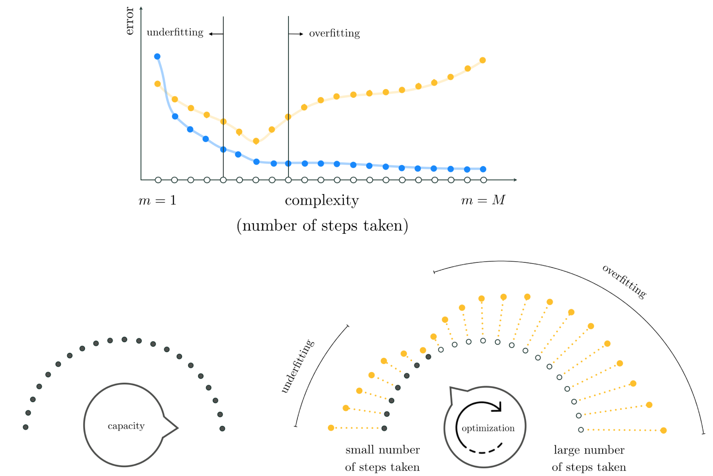
(top panel) A prototypical pair of training/validation error curves associated with a generic run of the early stopping regularization.
(bottom panels) We set our capacity dial all the way to the right and our optimization dial all the way to the left, slowly moving it from left to right in search of a model with minimum validation error. Here each notch on the optimization dial abstractly denotes a step of local optimization.

Slide 7
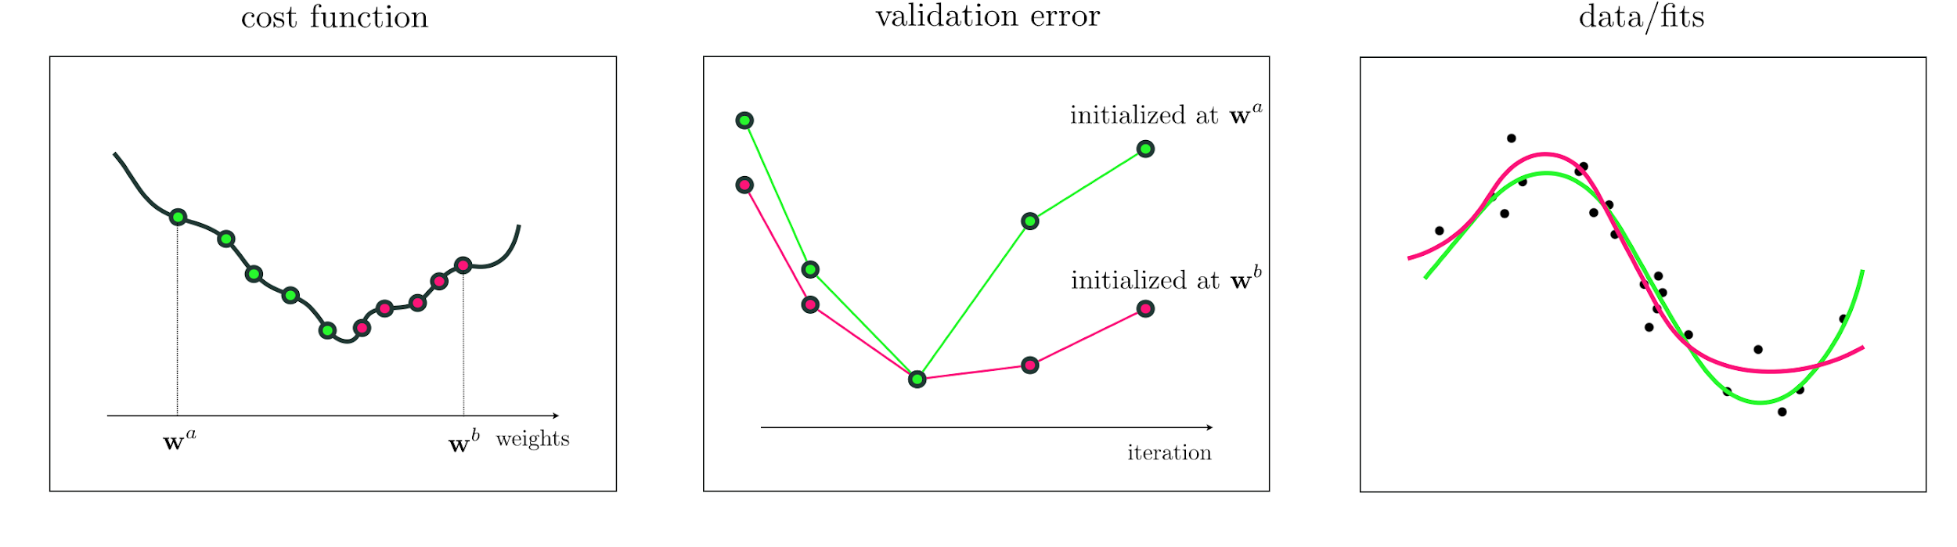
Is the model found by early stopping unique?
Different initializations can produce different trajectories towards potentially different minima of the cost function, and produce corresponding validation error minimizing models that differ in shape.

Slide 8
How high should capacity be set?
While there is no clear-cut answer to this question, the capacity must simply be set at least 'high' enough that the model overfits if optimized completely.

Slide 9
When is validation error really at its lowest?
While generally speaking validation error decreases at the start of an optimization run and eventually increases (making somewhat of a 'U' shape) it can certainly fluctuate up and down during optimization.
Often in practice a reasonable engineering choice is made as to when to stop based on how long it has been since the validation error has *not* decreased.
Moreover, one need not truly halt a local optimization procedure to employ the thrust of early stopping, and can simply run the optimizer to completion and select the best set of weights from the run (that minimize validation error) after completion.

Slide 10
Regularizer based methods

Slide 11
A regularizer is a simple function that can be added to a machine learning cost for a variety of purposes:
to prevent unstable learning
as a natural part of relaxing the support vector machine and multi-class learning scenarios
for feature selection
and, for regularization (which we discuss here)

Slide 12
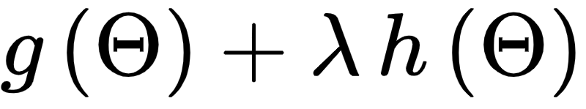
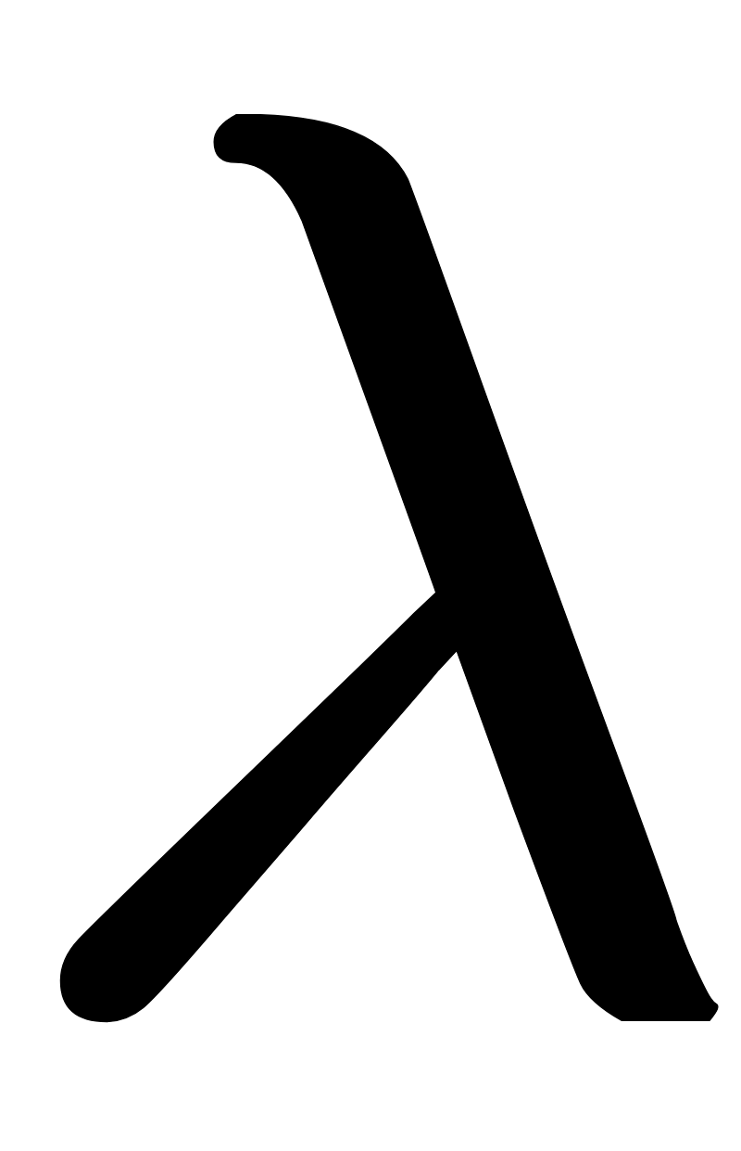
Denoting the original cost function by g, and the associated regularizer by h, the regularized cost is given as the linear combination of g and h as
Where is referred to as the *regularization parameter*.

Slide 13
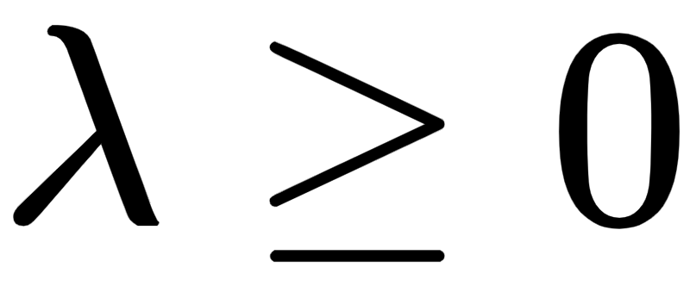
The regularization parameter
is always non-negative
controls the mixture of the cost and regularizer
when set very small, the regularized cost is essentially just g
when set very large the regularizer h dominates in the linear combination and drowns out g

Slide 14
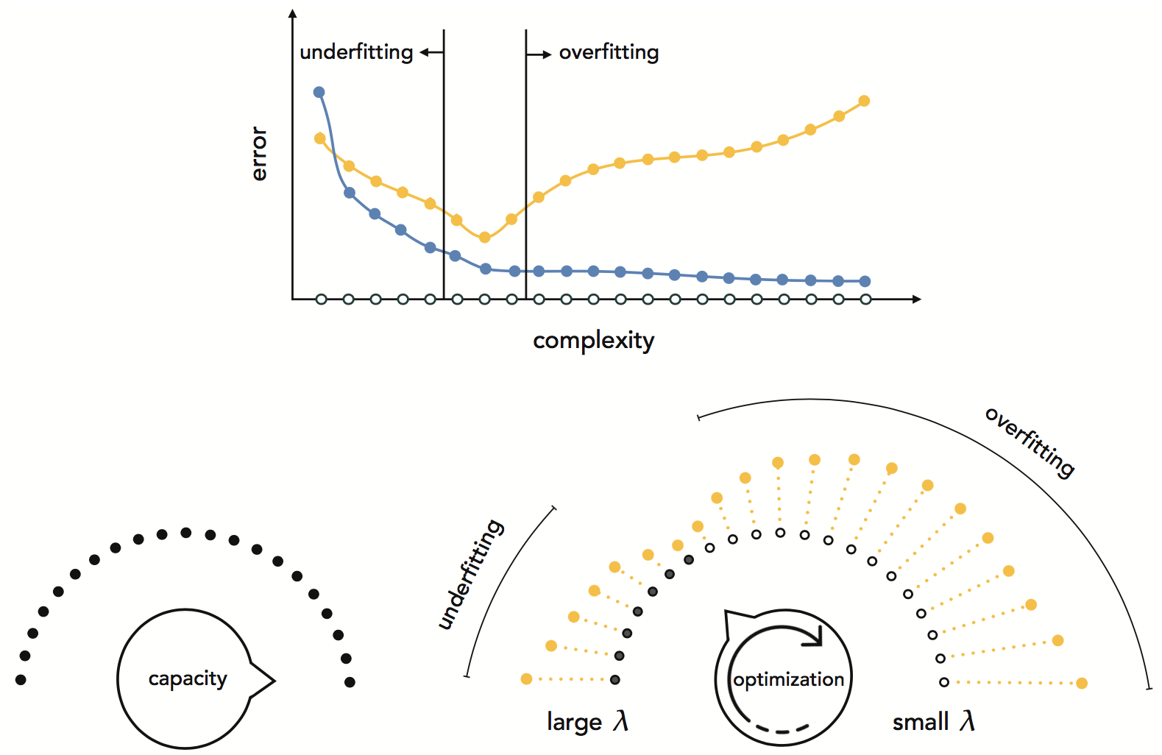
(top panel) A prototypical pair of training/validation error curves associated with a generic run of regularizer based cross-validation.
(bottom panels) Initially, the capacity dial is set all the way to the right and the optimization dial all the way to the left. We then slowly move our optimization dial from left to right by decreasing the value of , gradually increasing the complexity of our tuned model, in search of a tuned model with minimum validation error.

Slide 15
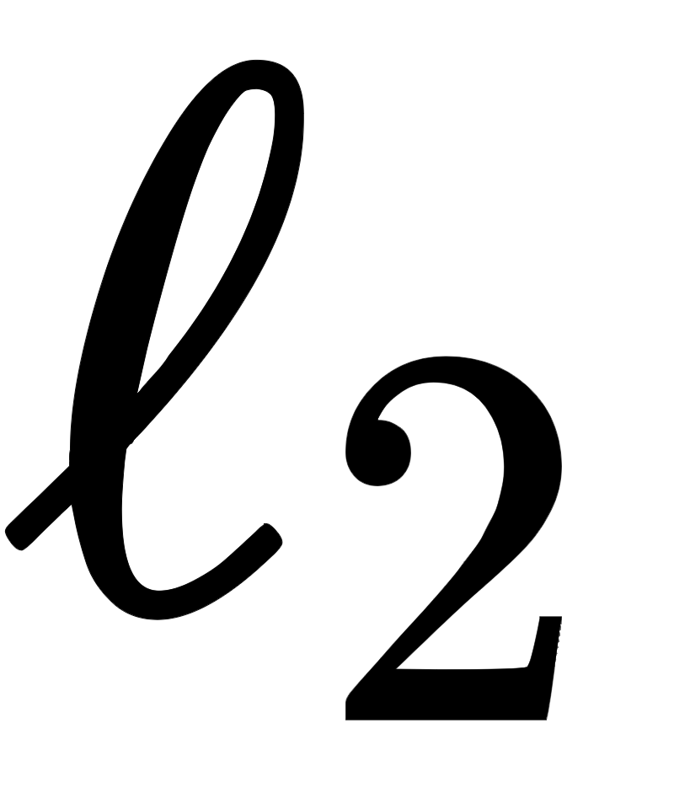
Implementation notes
Bias weights are often not included in the regularizer.
How many values we can try to tune the regularization parameter is often limited by computation and time restrictions, since for every value of tried a complete minimization of a corresponding regularized cost function must be performed.
While the squared norm is a very popular regularizer, one can use - in principle - any simple function as a regularizer. A few examples follow

Slide 16
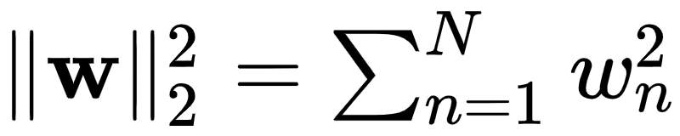
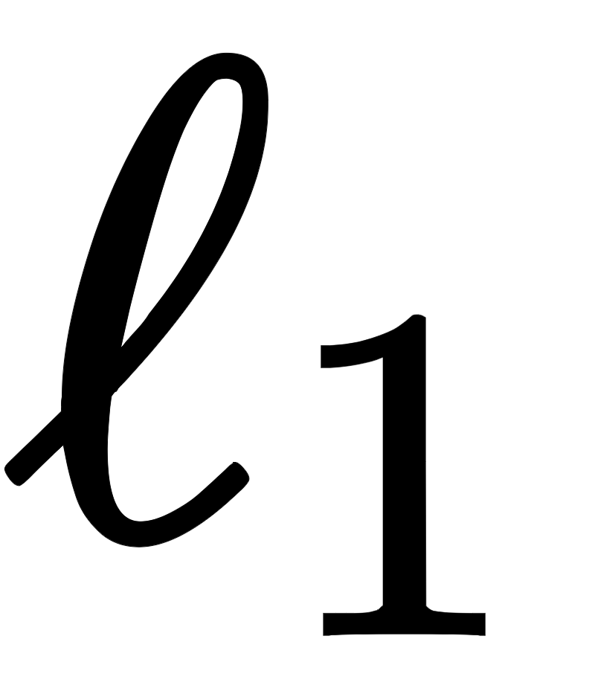
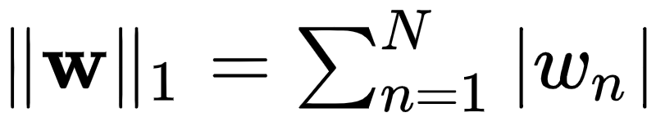
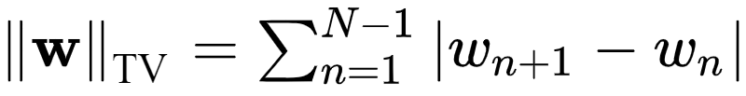
Popular regularizers in machine learning
The squared norm: defined as , this regularizer incentivizes weights to be small (in Euclidean sense).
The norm: defined as , this regularizer tends to produce sparse weights.
The total variation norm: defined as , this regularizer tends to produce smoothly varying weights.

Slide 17
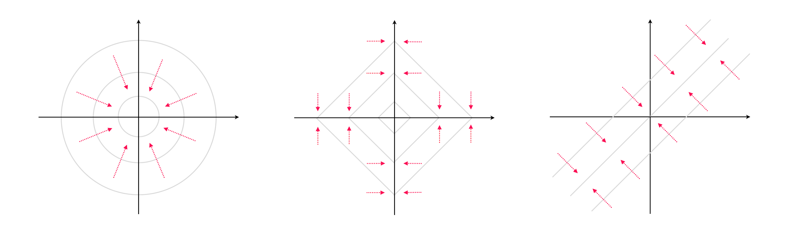
A visual depiction of where the (left panel), (middle panel), and total variation (right panel) functions pull global minima when used as a regularizer.

Slide 18
Example: Tuning a regularization parameter for regression

Slide 19
In this example we use an -regularized degree-10 polynomial model.
The training set/error is shown in light blue while the validation set/error is shown in yellow.
We try out 100 values of (i.e., the regularization parameter) between 0 and 1.

Slide 20
